Slide 1
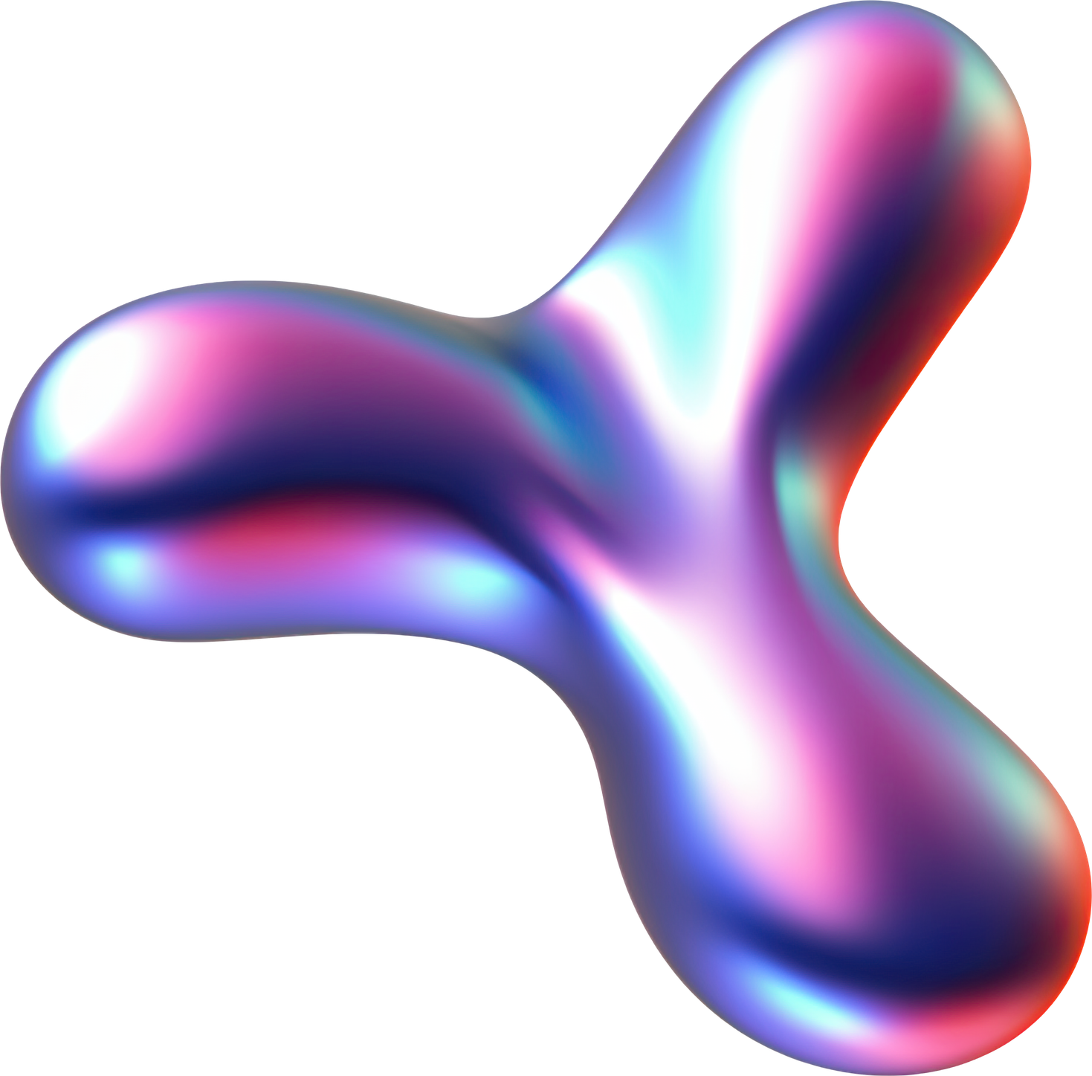
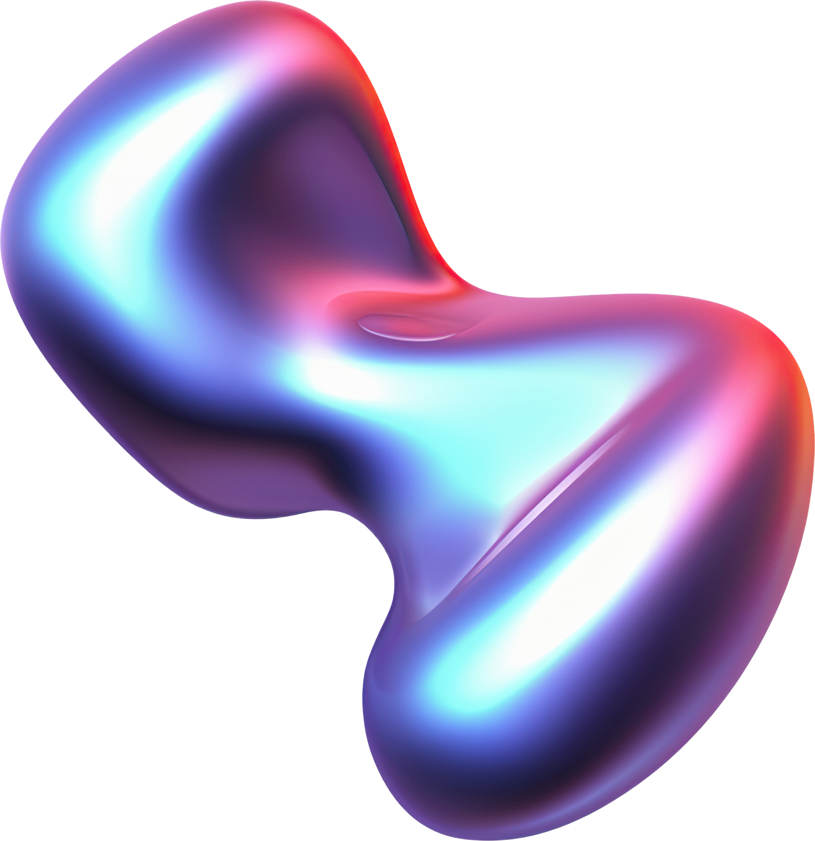
Jayden Cruz
Neural
Networks

Slide 2
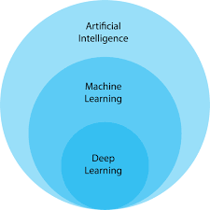
AI vs ML vs Deep Learning

Slide 3
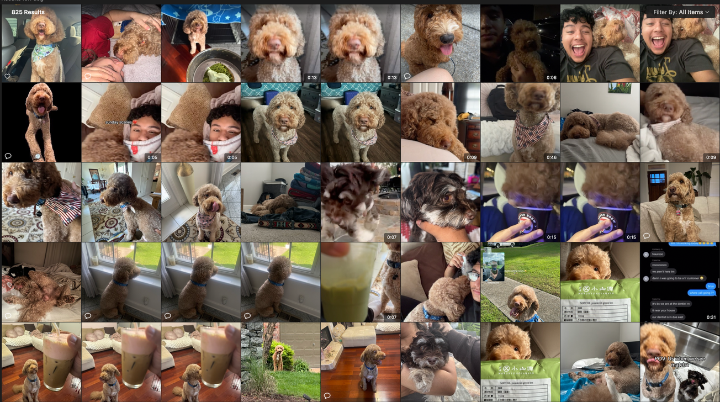
Why NN?
Traditional Programming:
We write explicit rules
NN:
Learn rules from data

Slide 4
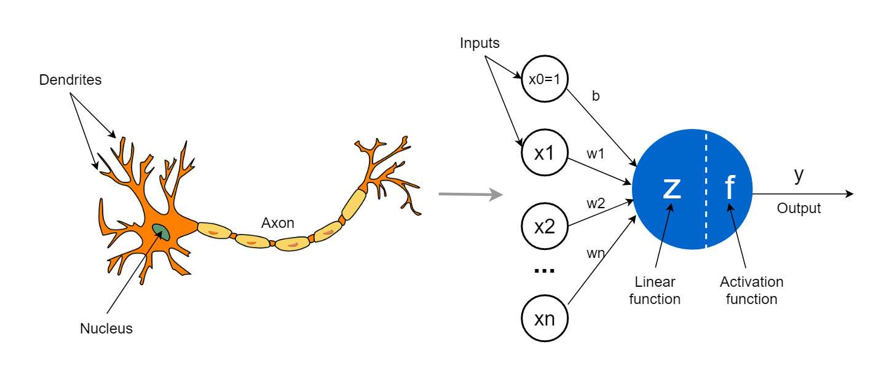

Biological Inspiration

Slide 5
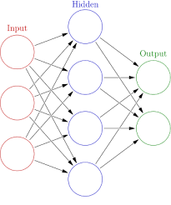
NN
DEF’N: A SERIES OF ALGORITHMS THAT ENDEAVORS TO RECOGNIZE UNDERLYING RELATIONSHIPS/PATTERNS IN A SET OF DATA THROUGH A PROCESS THAT MIMICS THE WAY THE HUMAN BRAIN OPERATES

Slide 6
Cont....
NEURON: Individual unit That mimic the biological behavior of the brain
Layer: A set of neurons stacked together in a row, they make up a layer(Each layer is a collection of neurons)
Neural Network: A set of multiple layers piled next to each other

Slide 7
Architecture
INPUT LAYER: RECEIVES FEATURES
HIDDEN LAYERS: EXTRACT PATTERNS
OUTPUT LAYER: PRODUCES PREDICTION
"THE DEPTH OF A NETWORK REFERS TO THE NUMBER OF HIDDEN LAYERS."

Slide 8
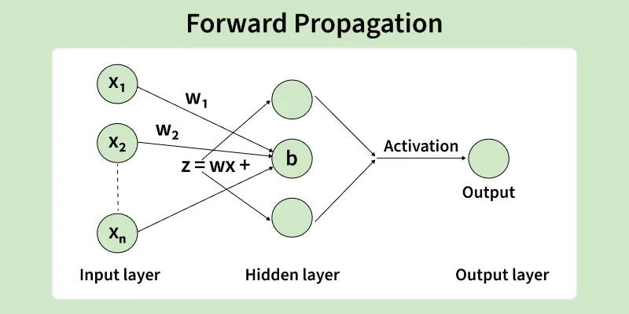
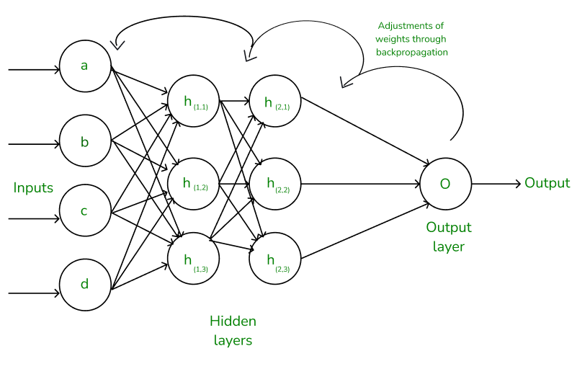
Forward & Back Propagation
Pass input through the network
Each layer computes weighted sum + activation
Final layer produces prediction
Works backward through the network to determine how each weight contributed to the error

Slide 9
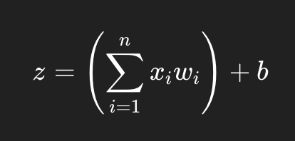
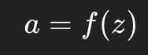
Inside a Neuron
Weights = importance
Bias = shift
Activation = introduces non-linearity
Without activiation functions, the network would just be a linear equation

Slide 10
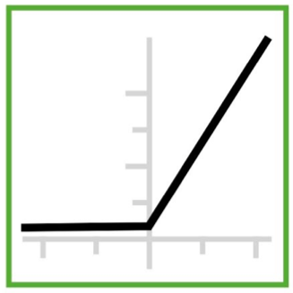
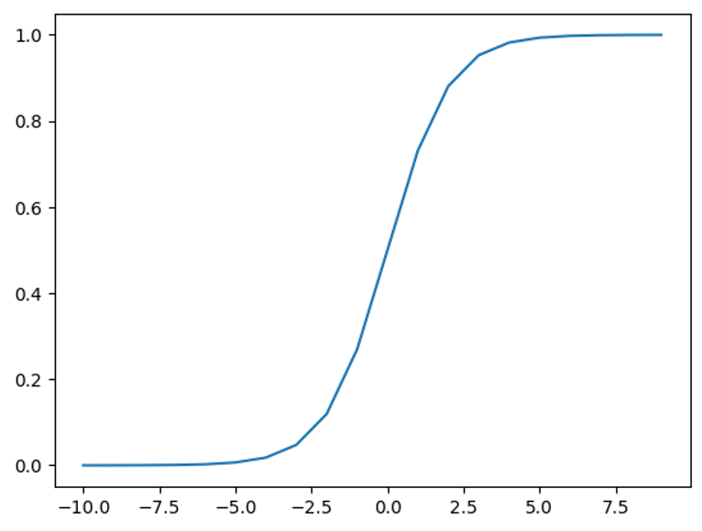
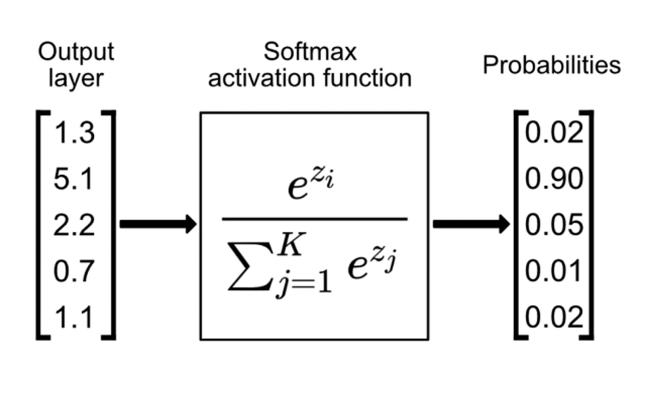
Activation Functions
ReLU
Sigmoid
Softmax
f(x)= max(0,x)
f(x) = 1/ 1+ e^-x
The elements of the output vector are in range [0, 1] and sum to 1

Slide 11
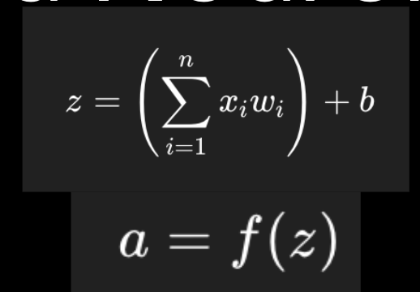
Neuron Example
Consider a single neuron with:
Weights: [0.2,0.5]
Bias: b=0.1
Activation Function: ReLU
Assume the input vector is:
x=[1,2]

Slide 12
How Networks Learn
Start with random weights
Make predictions (forward pass)
Measure error (loss)
Adjust weights (backpropagation)
Repeat
NN learn by minimizing error through optimization

Slide 13
Epochs
One Epoch = One full pass through the training dataset
for each batch:
forward propagation
compute loss
backpropagation
update weights

Slide 14
Train/Validation/Test
Training Set - used to learn weights
Validation Set - used to tune model
Test Set - used to evaluate final performance
Ex Split:
70 - 15 - 15

Slide 15
NN to Deep Learning
1 hidden layer → simple network
many hidden layers → deep learning
more layers → learn complex patterns

Slide 16
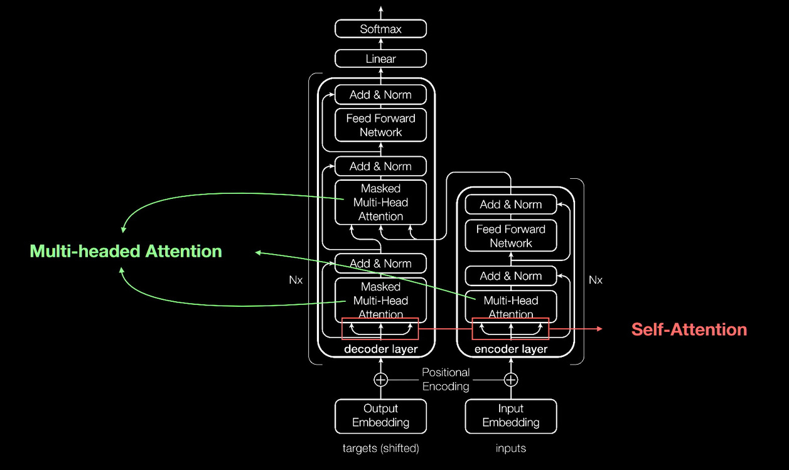
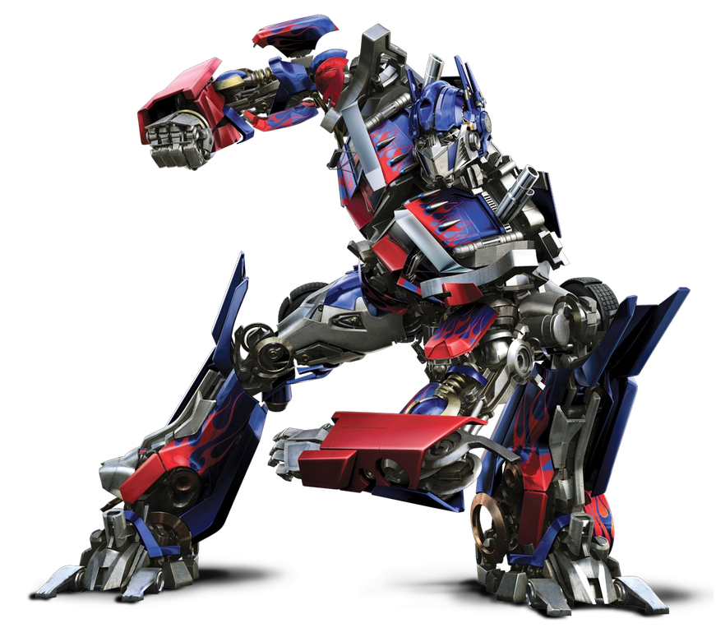
ChatGPT

Slide 17



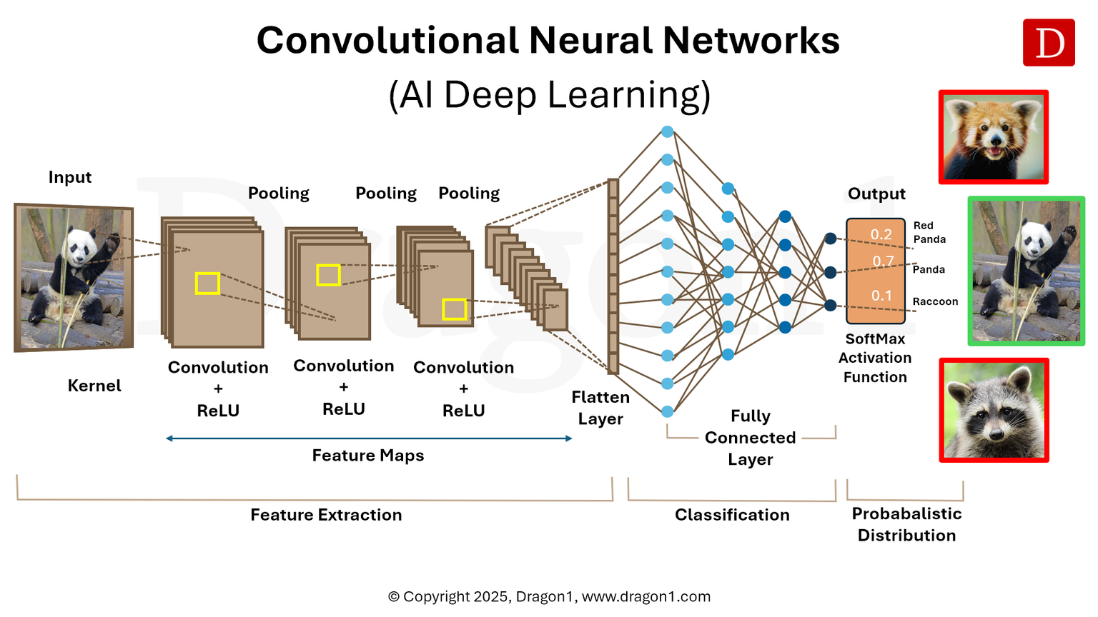

Self-Driving Cars

Slide 18
Other
Fraud detection
Medical diagnosis
Facial recognition
Recommendation systems
Voice assistants

Slide 19
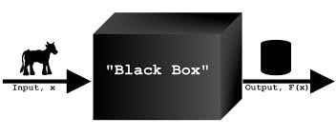
Strengths and Limitations
Pros:
High Accuracy
Learn Complex Patterns
Work with images text audio
Cons:
Require lots of data
Computationally expensive
Often a black box

Slide 20
Thank You!

